Slide 1
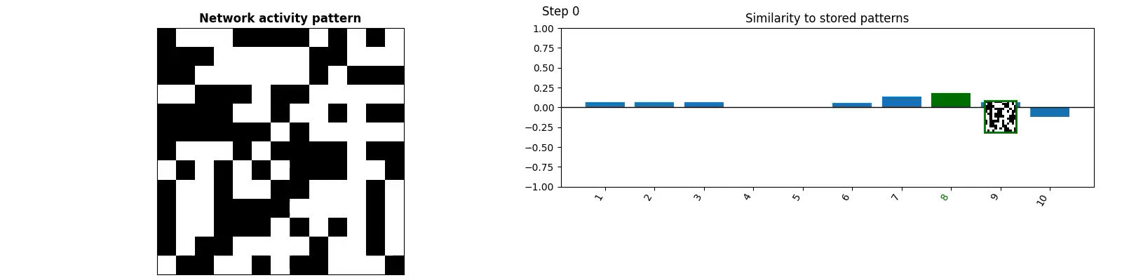
Modelling the hippocampus: Memory
Part 1
TReND Computational Summer School

Slide 2
Aims:
Introduce the Hippocampus
Explore its role in memory
Learn about associative memory networks
Understand how an associative memory matrix stores information through Hebbian learning and recurrent connectivity
Explain what is meant by the terms content-addressable, pattern completion, error correction and interference
Desxcribe how the anatomy of hippocampal region CA3 is consistent with models of associative memory
Tutorial: Building Hopfield Networks

Slide 3
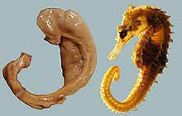
What and where is the hippocampus
Tucked into the centre of the brain, cashew-nut shaped region
Integration hub receiving inputs from all over cortex
Very well studied!
Implicated in memory (part 1) and spatial navigation (part 2)

Slide 4

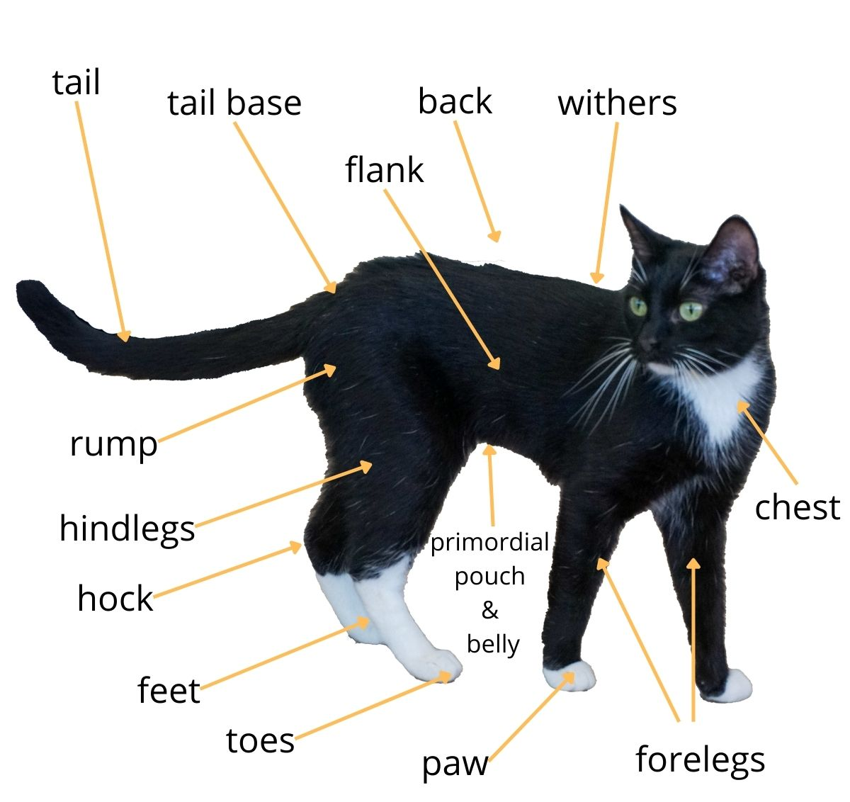
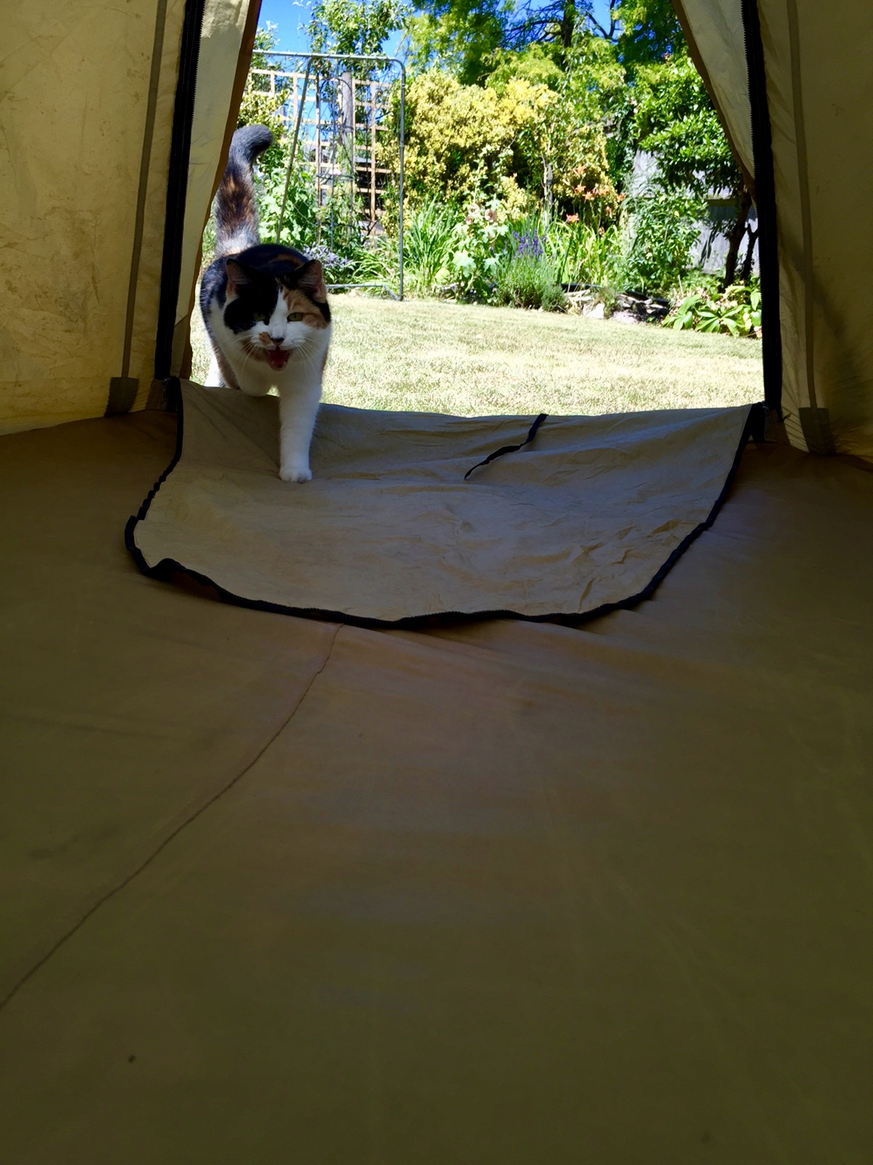
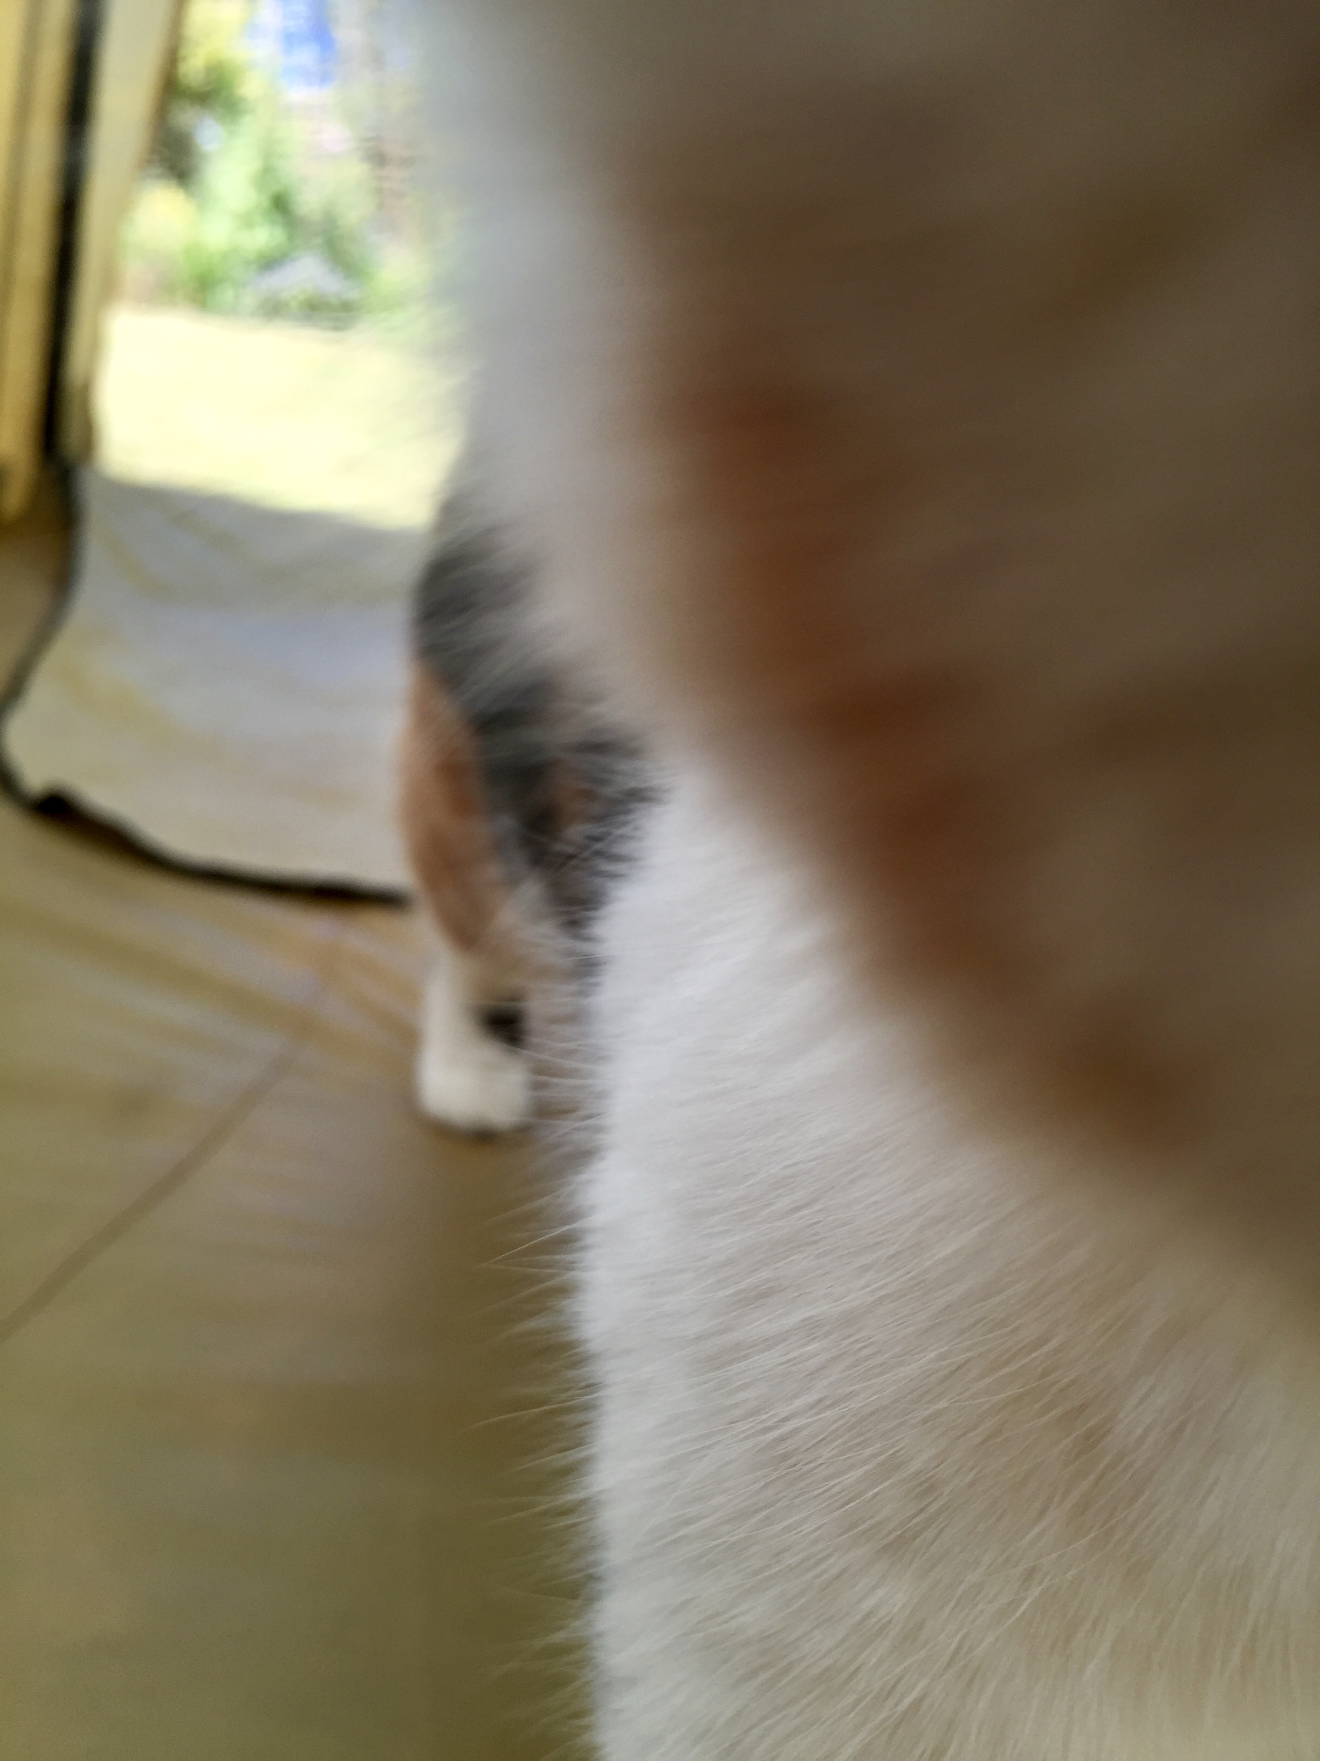

There are different categories of memory
Human memory
Long term memory
Short term memory
A name at a party
A telephone number
Imagining things
Declarative memory
Non-declarative memory
this lecture does not live here!
Motor skills
Habits
Emotional responses
Episodic memory
Semantic memory
Events
Times
Geography
Meanings of words
Facts
Associations

Slide 5
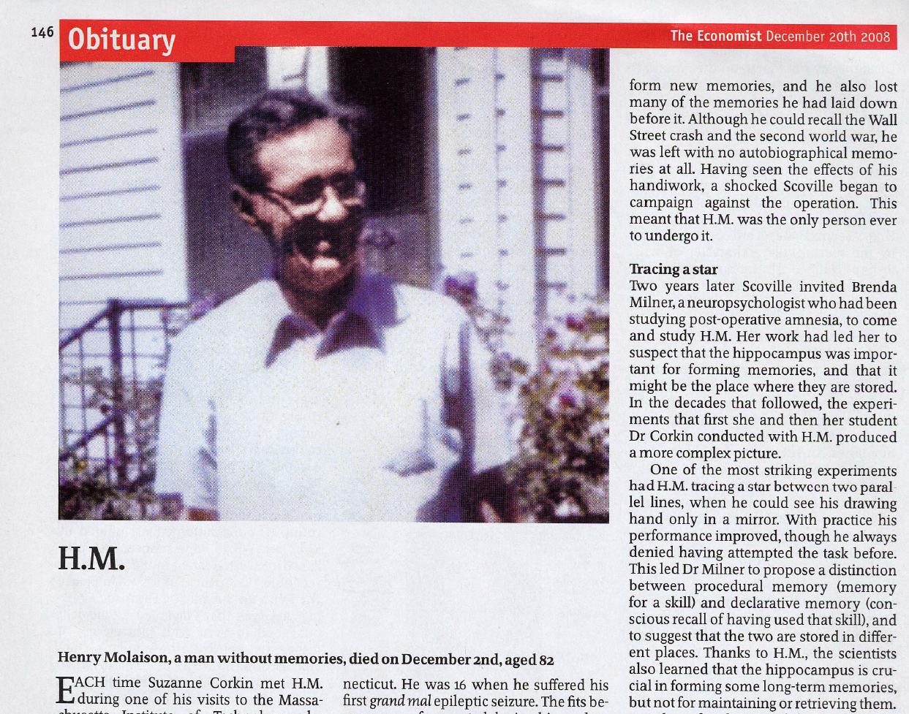
HM: A man without memories

Slide 6
Patient HM had a hippocampal lesion
This lead to the hypothesis that:
Hippocampus is necessary to form new memories and consolidate them to long term storage but is not, itself, the location of long term storage

Slide 7

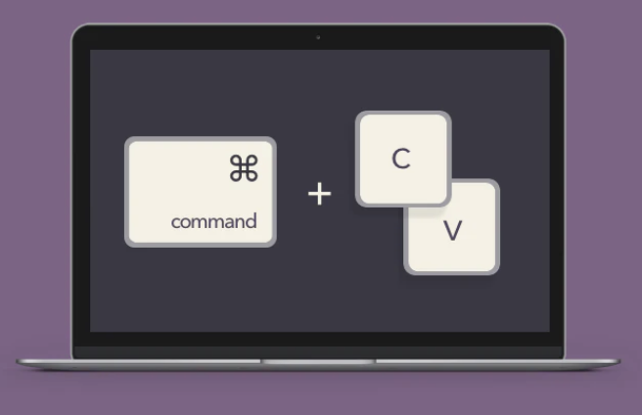
A useful analogy…
Computer Clip Board
Computer Hard Drive
Hippocampus
Cortex

Slide 8
So hippocampus has two memory roles:
Make and retrieve new memories
• Auto associative networks, CA3
Memory encoding
Send memories to long term storage in cortex
Sleep, “replay”
Memory consolidation

Slide 9

How do networks of neurons store memories?
We take memory for granted….what would it even mean for a network to “remember”
Content addressable memory:
Give a partial memory → Complete the memory
e.g.
Random access memory:
Give an address → Return the data
e.g. Computer memory, using a library

Slide 10
Hopfield (1982): Auto-associative memory
The million dollar question:
How should I set the weights so this network can “remember” a set of patterns.

Slide 11
Consider just one memory…
• What happens if the network at a different pattern which is nearby to the stored one?
Answer: We recover the old memory

Slide 12
What if we want to embed many memories?
• What happens if the network at a different pattern which is nearby to the stored one?
Answer: We recover the old memory

Slide 13
Consider just one memory…
To embed many memories, we can just add more terms to the

Slide 14
A working example might help
Imagine we have the following three patterns:
Starting near x₁, , calculate the next state:

Slide 15
If there are many memories…

Slide 16
The “Energy” view

Slide 17
How would neurons learn the weight matrix?
“cells that fire together wire together” – Donald Hebb 1949
“any two cells or systems of cells that are repeatedly active at the same time will tend to become ‘associated’ so that activity in one facilitates activity in the other”

Slide 18
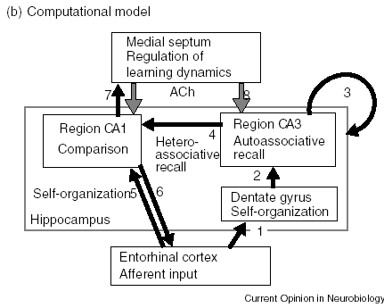
Hasselmo 1995 combined all these ideas
Sensory inputs from EC are sent to DG where they are “orthogonalized”
These are then committed to memory in the CA3
Hetero-associative recall: Input patterns in CA3 recall memories in CA1

Slide 19
Modelling the hippocampus: Representations of space
Part 2
TReND Computational Summer School

Slide 20
Aims:
Explore the role of Hippocampus in spatial navigation
Learn about spatial representations and velocity-selective representations in the Hippocampus and neighbouring regions
Place cells
Grid cells
Boundary vector cells
Head direction cells
Tutorial: Modelling locomotion and spatial representations using the RatInABox software package.

Slide 21
Grid cells to place cells: A model
Grid cells sit one synapse up from place cells in the hippocampus.
It might be possible that we can add grid cells together to get place cells
Here’s a simple model
This predicts that large grid

Slide 22
